Slide 1

Multi-Terrain Locomotion of Lizard Robot
Mahdi Khoramshahi
Nitish Thatte

Slide 2
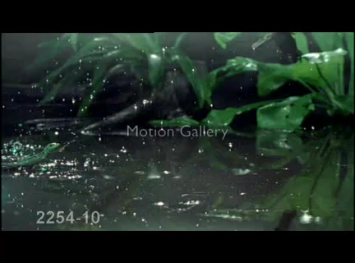

Slide 3
Water Running
Force generated from fluid drag [2]
Must withdraw foot form air cavity before it collapses [1]
Air Cavity
Water
Steven Floyd and Metin Sitti. Design and development of the lifting and propulsion mechanism for a biologically inspired water runner robot. Robotics, IEEE Transactions on, 24(3):698–709, 2008.
JW Glasheen and TA McMahon. Vertical water entry of disks at low Froude numbers. Physics of Fluids, 8(8):0–5, 1996.

Slide 4
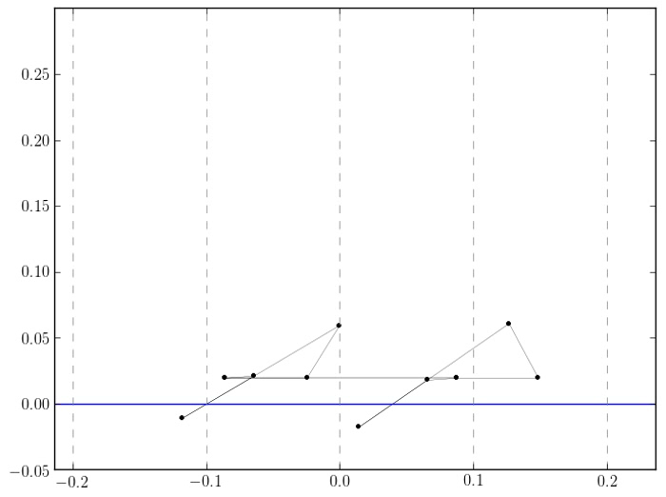

Slide 5
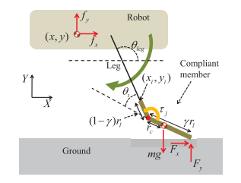
Ground Running
Foot deflection dynamics [3]
Ground contact model
HS Park and Metin Sitti. Compliant footpad design analysis for a bio-inspired quadruped amphibious robot. Intelligent Robots and Systems, 2009. IROS . . . , pages 1–11, 2009.

Slide 6
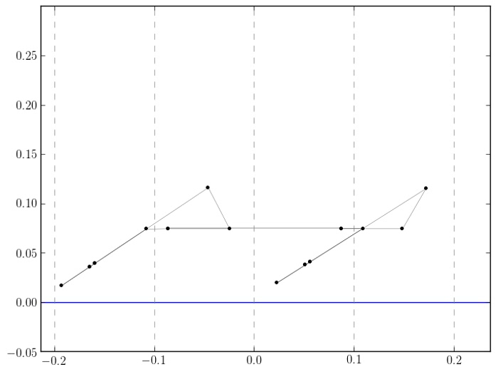

Slide 7
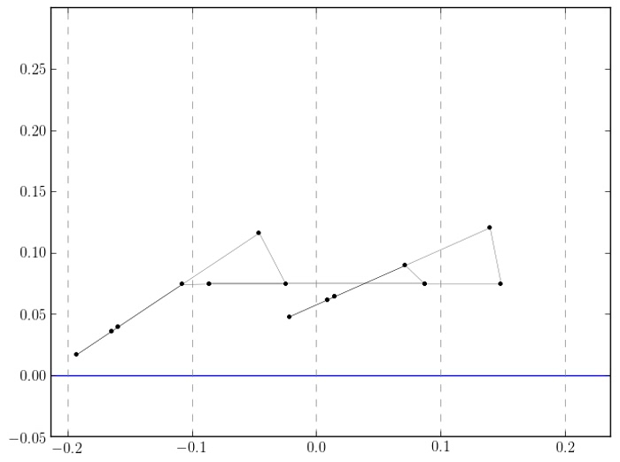

Slide 8
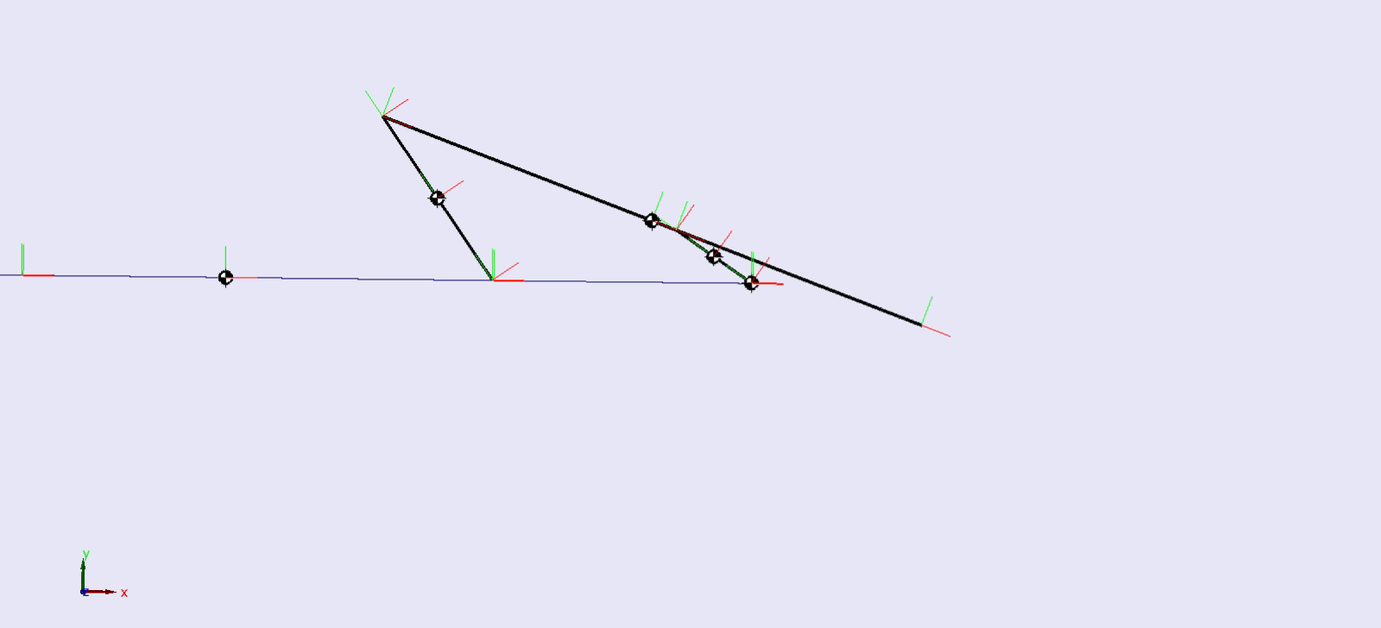
Modeling one leg

Slide 9
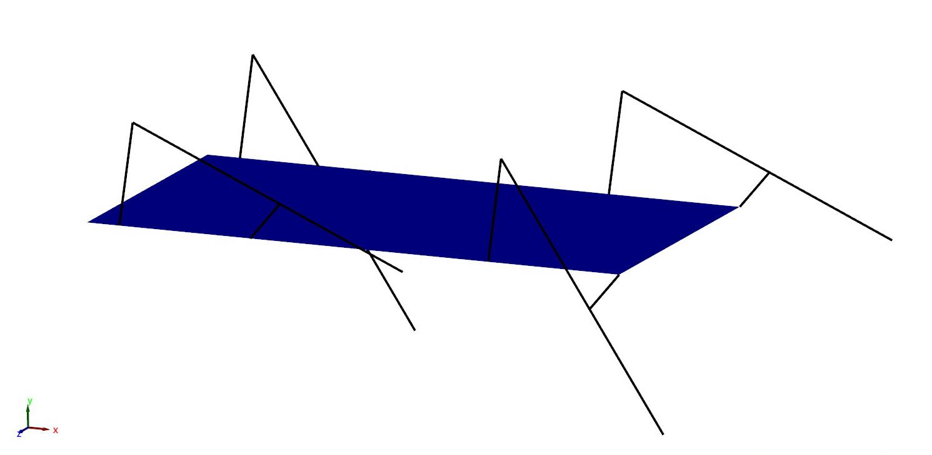



Slide 10
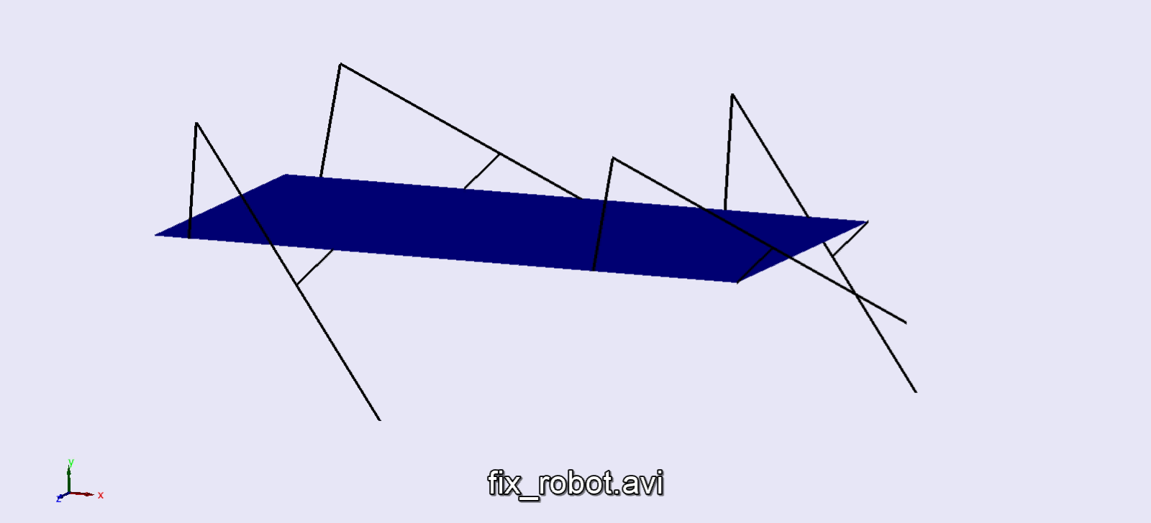

Slide 11
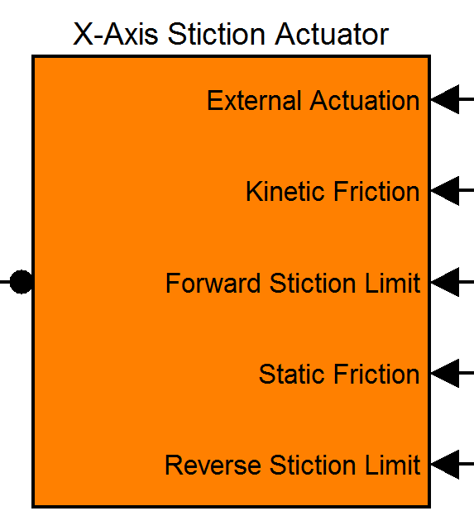
Ground contact model
0

Slide 12
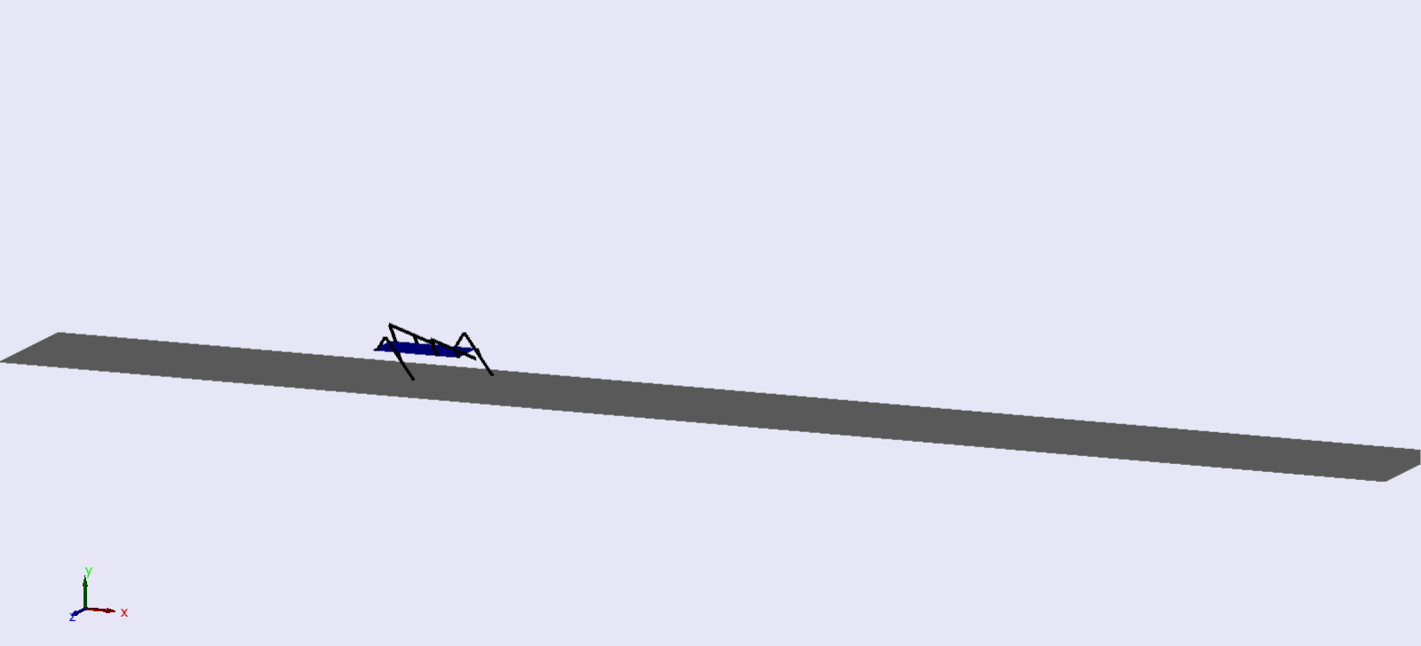

Slide 13
A Linear Search

Slide 14
Cost of Transport

Slide 15
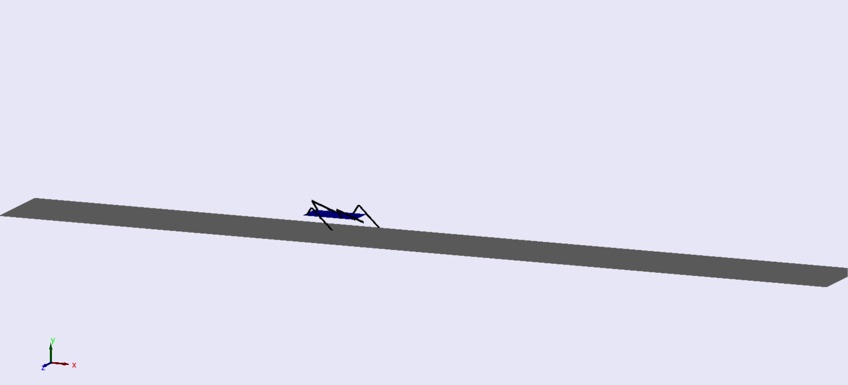
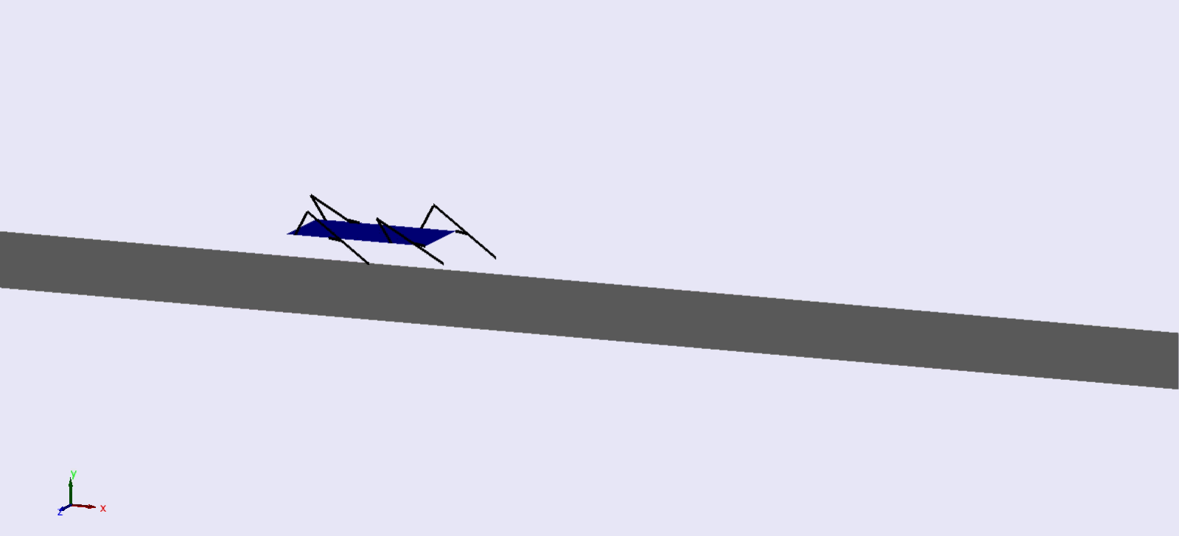
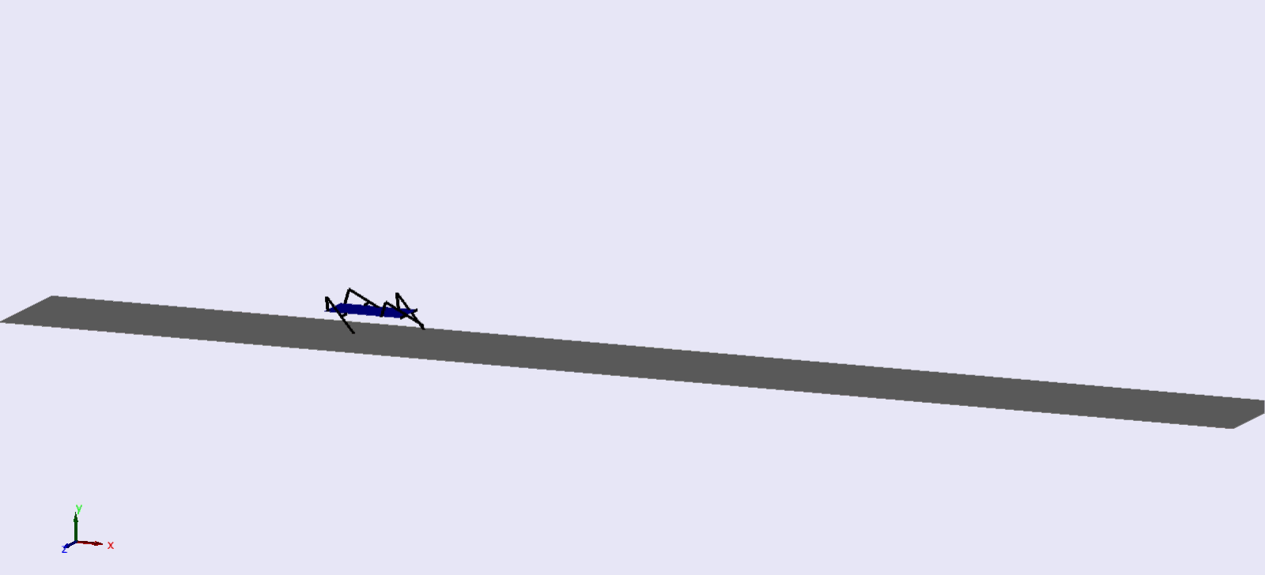
COT, what does it mean?

Slide 16
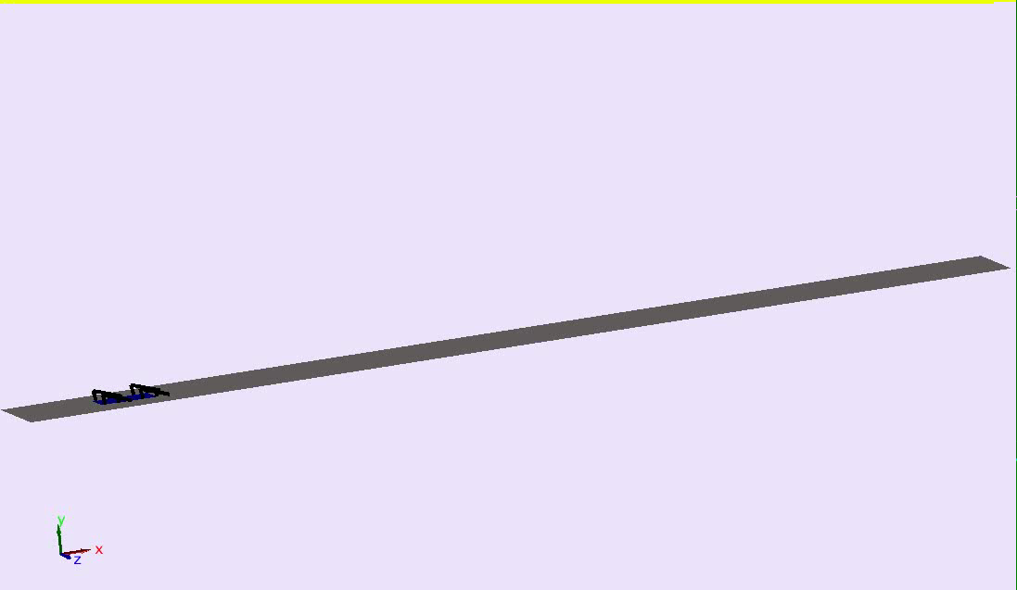

Slide 17
A Linear Search

Slide 18
Cost of Transport

Slide 19
Linear Search

Slide 20
Linear Search

Slide 21
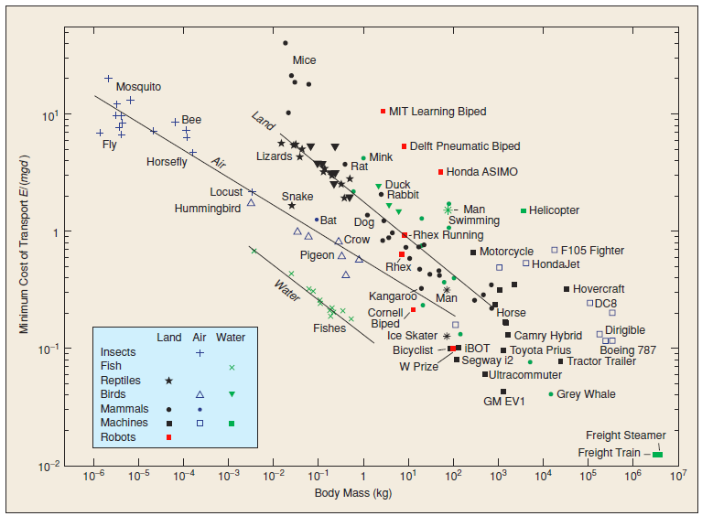
Comparison
Ground
Water
A. D. Kuo, “Choosing Your Steps Carefully,” IEEE Robotics Automation Magazine, vol. 14, no. 2, pp. 18 –29, Jun. 2007

Slide 22
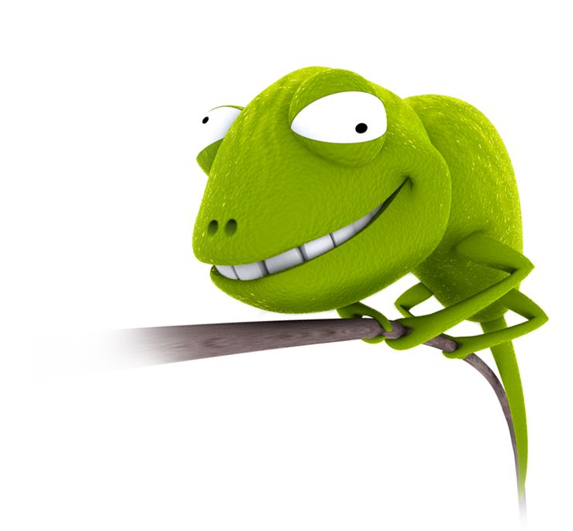
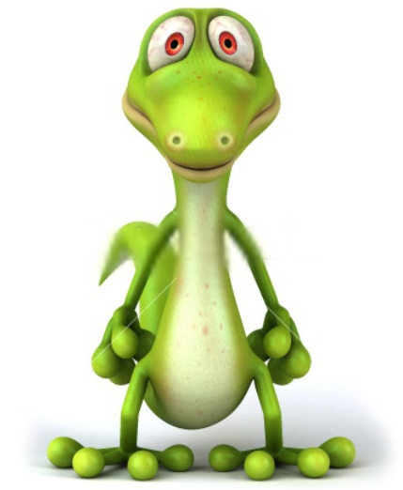
Our plan
Remake simulation using SimMechanics V2
Better animation capabilities
Can import CAD models more easily
Advanced numerical tolerancing
Redo electronics with Jason’s help
Offboard electronics for weight reduction and safety
Arduino Mega
PCB with motor controllers and encoder counters
New mechanical design
Tail Design

Slide 23
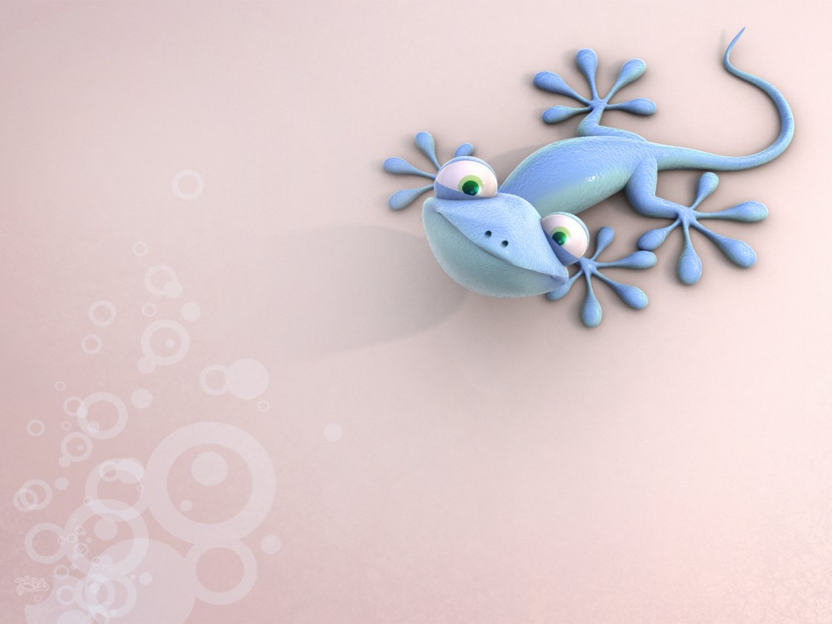
Questions?

Slide 24
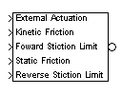
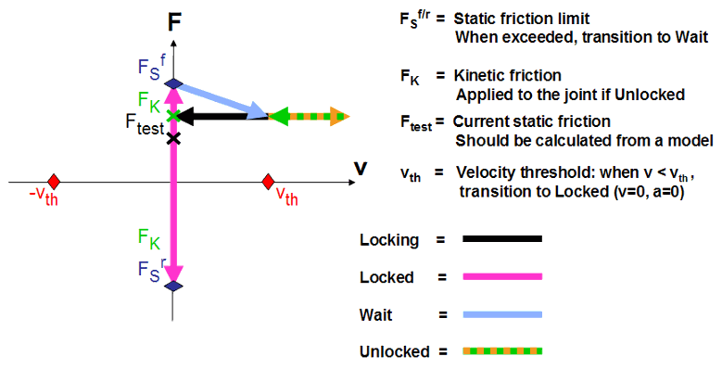
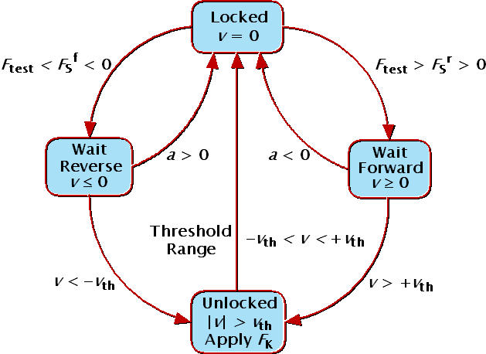
Ground contact model

